Slide 1

Komunikace s GPS modulem PA6H
Martin Košút
Jan Hocz
Department of Radio Electronics Brno University of Technology
December 18, 2019

Slide 2
Výstup z GPS modulu PA6H
NMEA data
GPGGA (GPS Fix Data)
GPGSA (GPS DOP and active satellites)
GPRMC (Recommended minimum specific GPS data)
GPVTG (Track made good and ground speed)
GPGSV (GPS Satellites in view)
$GPGGA,080454.000,4913.6219,N,01634.4144,E,1,6,2.13,287.1,M,43.5,M,,*5F
$GPGSA,A,3,01,03,23,11,19,17,,,,,,,2.32,2.13,0.94*01
$GPGSV,4,1,13,01,75,146,31,03,64,276,25,11,54,185,31,17,34,302,21*75
$GPGSV,4,2,13,39,32,168,,23,28,205,30,31,24,092,14,19,21,319,16*7B
$GPGSV,4,3,13,32,16,046,,08,03,182,,09,01,213,,22,,,25*47
$GPGSV,4,4,13,14,,,29*75
$GPRMC,080454.000,A,4913.6219,N,01634.4144,E,3.47,339.04,271119,,,A*65
$GPVTG,339.04,T,,M,3.47,N,6.42,K,A*30
Komunikace s GPS modulem PA6H

Slide 3
Zpracovávané a zobrazované data
Čas (UTC)
Zeměpisná šířka, délka (převod formátu na D.DDDDDD°)
Rychlost (km/h)
Výška (m)
Počet aktivních satelitů
Kontrola správnosti dat pomocí checksum
$GPGGA,080454.000,4913.6219,N,01634.4144,E,1,6,2.13,287.1,M,43.5,M,,*5F
$GPGSA,A,3,01,03,23,11,19,17,,,,,,,2.32,2.13,0.94*01
$GPGSV,4,1,13,01,75,146,31,03,64,276,25,11,54,185,31,17,34,302,21*75
$GPGSV,4,2,13,39,32,168,,23,28,205,30,31,24,092,14,19,21,319,16*7B
$GPGSV,4,3,13,32,16,046,,08,03,182,,09,01,213,,22,,,25*47
$GPGSV,4,4,13,14,,,29*75
$GPRMC,080454.000,A,4913.6219,N,01634.4144,E,3.47,339.04,271119,,,A*65
$GPVTG,339.04,T,,M,3.47,N,6.42,K,A*30
Komunikace s GPS modulem PA6H

Slide 4
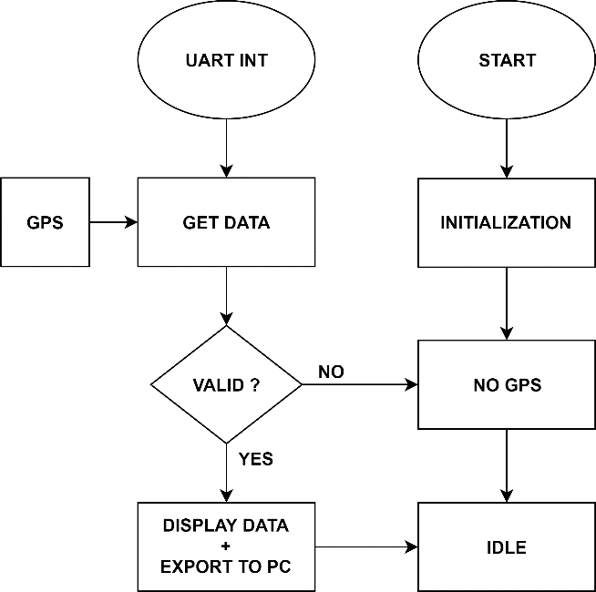
Vývojový diagram
Komunikace s GPS modulem PA6H

Slide 5
Exportovaná data
UART
*.csv
Mapa Video
Time,Latitude,Longitude,Speed[km/h],Altitude[m],Active_Satelites,
14:36:10,+49.226879,+16.573978,0.45,296.8,5,
14:36:11,+49.226883,+16.573971,0.03,297.3,5,
14:36:12,+49.226883,+16.573967,0.15,297.6,5,
14:36:13,+49.226883,+16.573963,0.11,297.6,5,
14:36:14,+49.226883,+16.573963,0.24,297.7,5,
14:36:15,+49.226883,+16.573965,0.29,297.7,5,
14:36:16,+49.226883,+16.573963,0.12,297.7,5,
14:36:17,+49.226883,+16.573963,0.10,297.7,5,
14:36:18,+49.226883,+16.573961,0.12,297.7,5,
Komunikace s GPS modulem PA6H

Slide 6
Děkujeme za pozornost
Komunikace s GPS modulem PA6H

